Slide 1


DEPI
CUSTOMER CHURN PREDICTION AND ANALYSIS
Customer Churn
Prediction and Analysis
DATA SCIENCE TRACK – ROUND 2
Group: CAI2_AIS4_S1
Instructor: Ahmed Moustafa
GitHub: PROJECT LINK
DEPI

Slide 2

OUR TEAM
Let's meet our team members
ZIAD MOATAZ SAMY (21067779)
AHMED MOHAMED RADWAN (21057072)
ABDELRAHMAN RAWHY (21091992)
ALI ELDIN AHMED (21085612)
AHMED NASSER (21074056)
AHMED GAMAL (21085587)
OMAR OSAMA (21079477)

Slide 3

ABSTRACT
Problem: Customer churn is a critical challenge in telecom, where retaining customers is more cost-effective than acquiring new ones.
Solution:
Analyzed the Telco Customer Churn dataset using EDA and machine learning.
Engineered features like Customer Lifetime Value (CLV) and service counts.
Identified key churn drivers: contract type, payment methods, and service usage.
Built predictive models to flag at-risk customers.
Impact: Provides actionable insights to improve retention strategies.

Slide 4
INTRODUCTION
Why It Matters:
Telecom industry faces fierce competition; loyalty is hard-won.
Data-driven churn prediction helps retain customers and reduce revenue loss.

Slide 5
INTRODUCTION
Project Goals:
Analyze churn patterns using demographics, services, and contracts.
Predict churn risk using machine learning.
Recommend retention strategies.

Slide 6
DATASET OVERVIEW
Source: Kaggle (Telco Customer Churn Dataset)
Size: 7,043 customers × 21 features
Key Features:
Demographics (gender, senior status)
Services (internet, phone, streaming)
Financials (monthly charges, tenure)
Target: Churn (Yes/No)

Slide 7
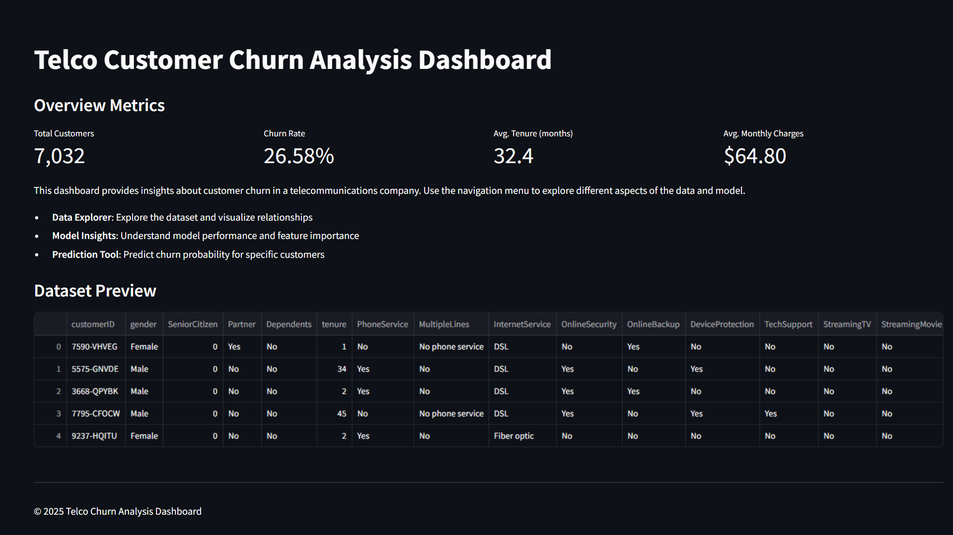

Slide 8


EXPLORATORY
DATA ANALYSIS (EDA)
Key Insights:
Gender: Balanced (50% male, 50% female).
Senior Citizens: 16.2% of customers.
Tenure: Most customers stay 1–12 months or 60+ months.
Payment Methods: Electronic checks dominate (34%).
Churn Rate: 26.5% of customers churned.

Slide 9
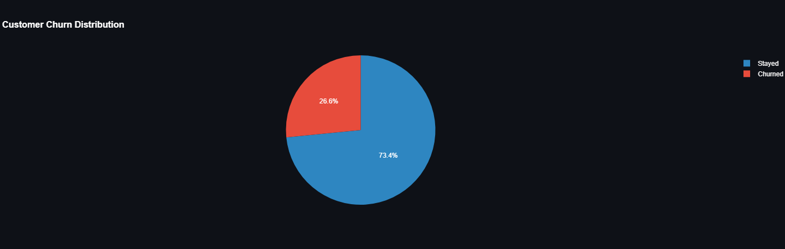
EXPLORATORY
DATA ANALYSIS (EDA)
Customer Churn Distribution
Stayed
Churned

Slide 10

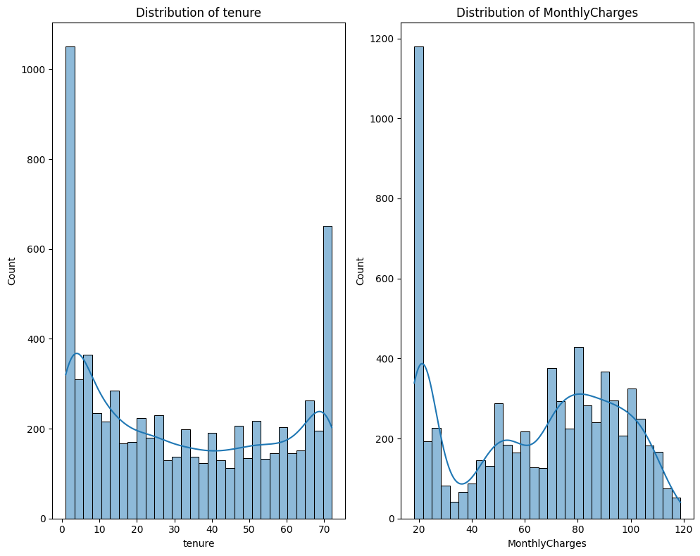
Tenure
vs
MonthlyCharges

Slide 11


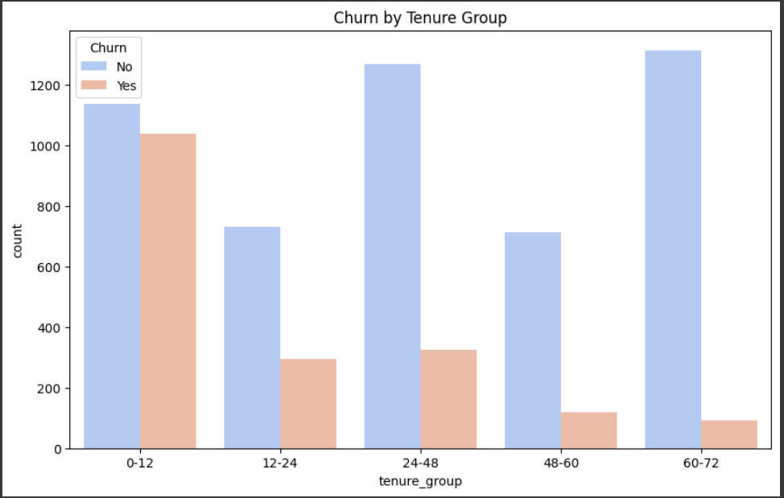
Tenure for churn

Slide 12
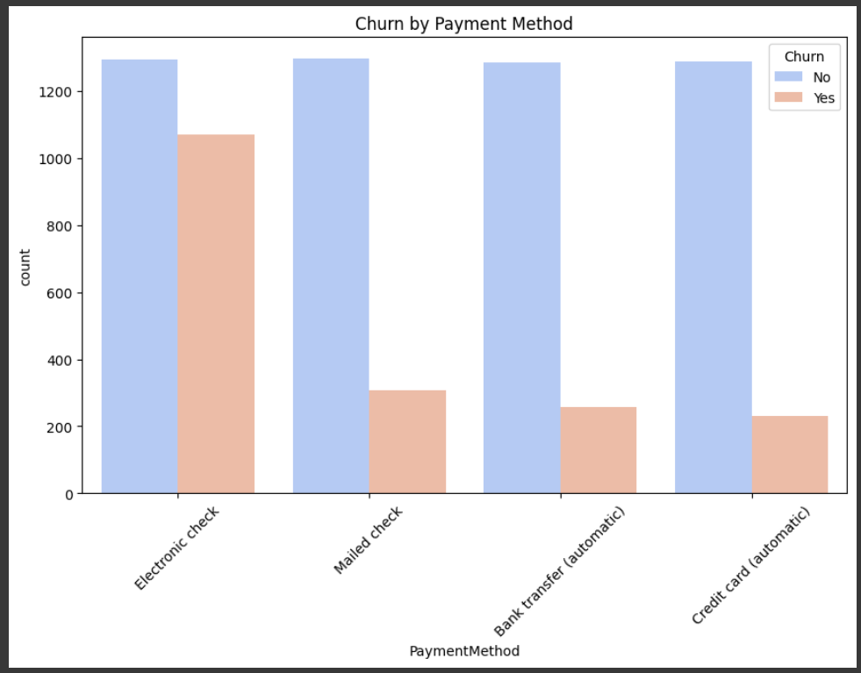
Tenure for
payment method

Slide 13
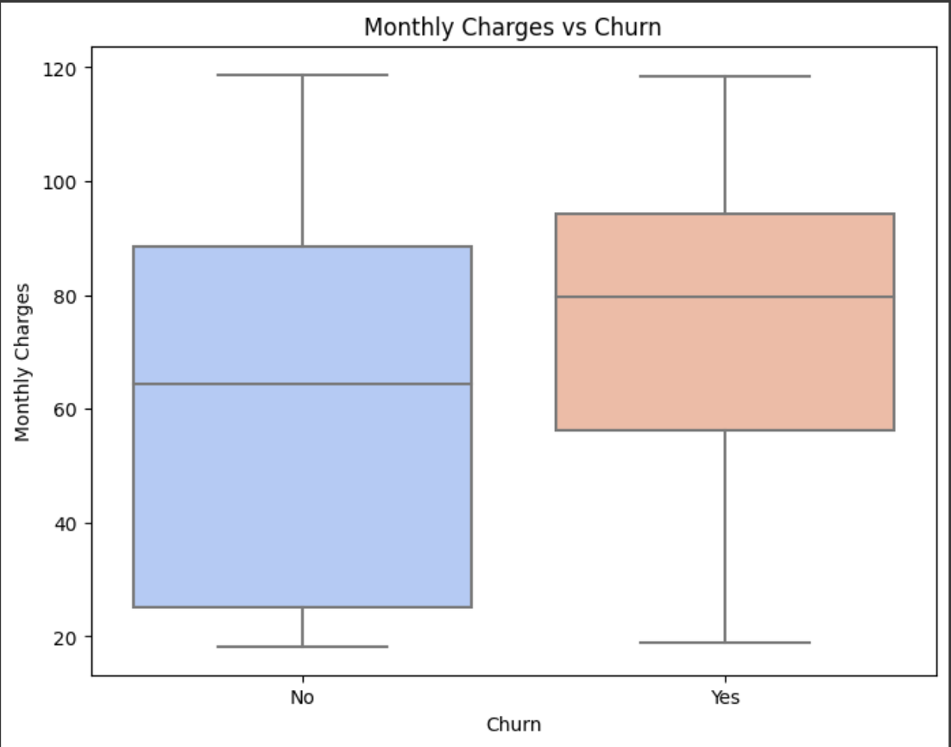
Boxplot
Monthly Charges
vs
Churn

Slide 14

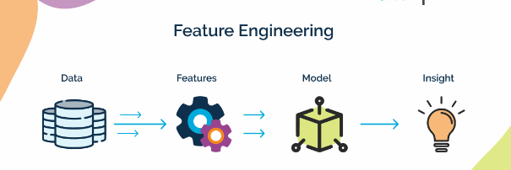
FAETURE ENGINEERING
Handled Missing Values:
Replaced missing values in numerical and categorical columns (e.g., TotalCharges) with mean or mode.
Converted Data Types:
Converted TotalCharges from string to numeric for analysis.
Created Tenure Groups:
Binned tenure into categories (e.g., "0–12", "13–24", ...) for better churn pattern analysis.
Encoded Categorical Features:
Used Label Encoding for binary columns (Yes/No).
Applied One-Hot Encoding for columns with multiple categories (e.g., InternetService).
Dropped Unnecessary Columns:
Removed customerID and duplicated or irrelevant columns to reduce noise.
Standardized/Normalized Data:
Scaled numerical features (like MonthlyCharges, TotalCharges) using StandardScaler for better model performance.

Slide 15
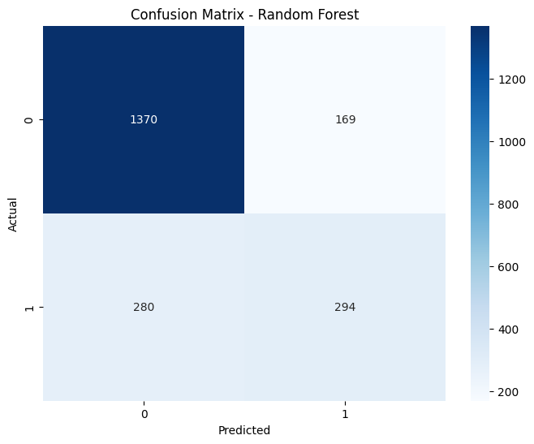
Classification report
Confusion Matrix
-
Random Forest

Slide 16

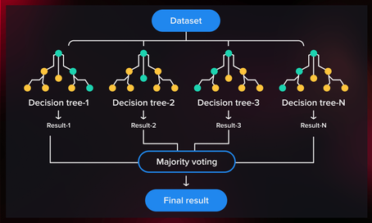
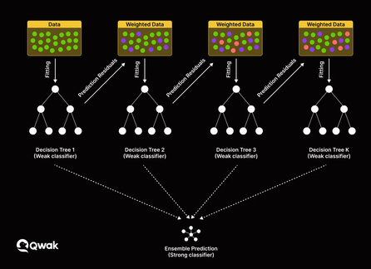
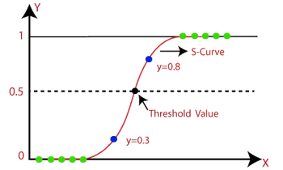
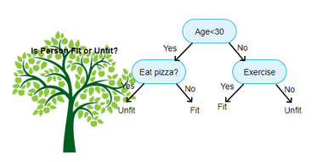
MODELING
(GRID SEARCH)
Random forest classifier
XGboost
n_estimators
max_depth
min_samples_split
min_samples_leaf
bootstrap
n_estimators
max_depth
learning_rate
subsample
colsample_bytree
Accuracy: 0.78%
ROC-AUC: 0.82%
Accuracy: 0.80%
ROC-AUC: 0.83%
Logistic Regression
Decision Tree Model
Accuracy: 0.79%
ROC-AUC: 0.83%
Accuracy: 0.72%
ROC-AUC: 0.66%

Slide 17

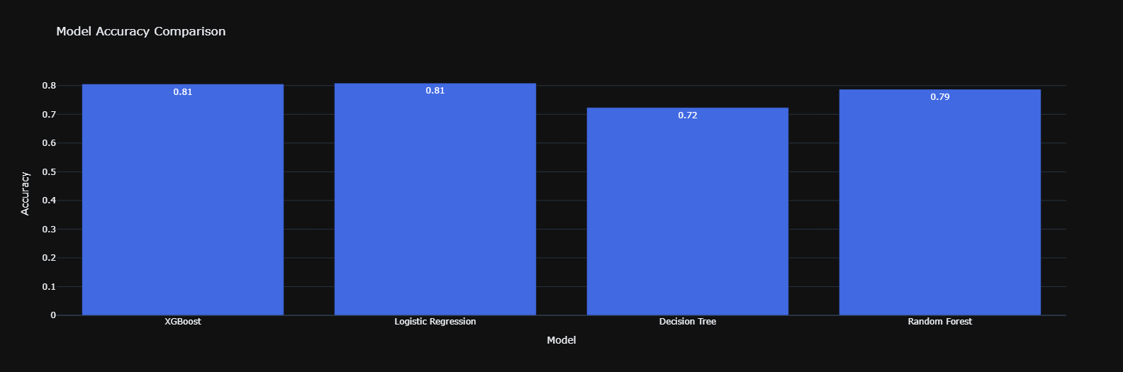
Model Accuracy

Slide 18
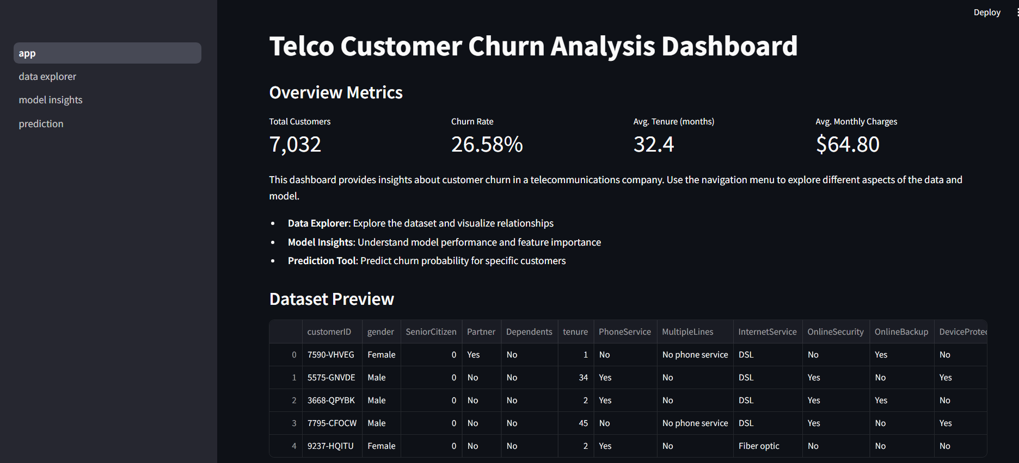
DASHBOARD

Slide 19

STREAMLIT
DEPLOYMENT
HOSTING
HTTPS://TELCO-CHURN-DASHBOARD.STREAMLIT.APP/

Slide 20

THANK YOU

